Slide 1
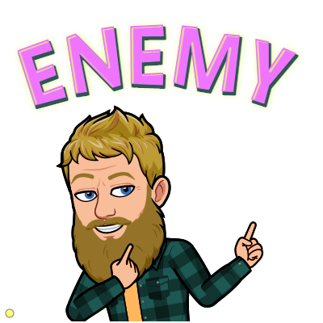
Generative Adversarial Networks
Week 9
Brian Spiering

Slide 2
Tuesday Agenda
4:00 - 4:15: Welcome & Review
4:15 - 5:00: Generative Adversarial Nets (GANs) Introduction
5:00 - 5:05: Break
5:05 - 5:55: Live Assignment
5:55 - 6:00: Break
5:00 - 5:55: Generative Adversarial Nets (GANs) Applications and Limitations
6:50 - 7:00: Wrap-up

Slide 3
Saturday Agenda
9:00 - 9:25: Welcome & Review
9:25 - 9:55: Image segmentation
9:55 - 10:00: Break
10:05 - 10:55: Live Assignment
10:55 - 11:00: Break
11:05 - 11:55: Problem Solving for Technical Interviews
11:55 - 12:00: Wrap-up
12:00 - 12:30: Lunch break

Slide 4
Questions about any previous materials?

Slide 5
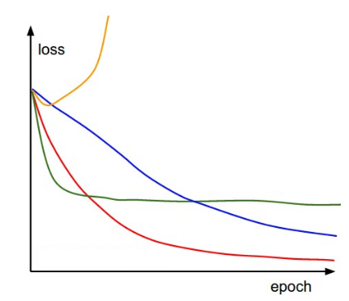
Review Prompts
What does softmax do in neural networks?
If Momentum is added to SGD, the parameter vector will build up “velocity” in any direction that _______.
What is happening with each of these learning rates? Which one is the best?

Slide 6
Learning Objectives
Draw Generative Adversarial Networks (GANs) architecture.
Explain how GANs can learn to create realistic images.
List common applications of GANs.
Describe common problems and limitations of GANs.
To learn model implementation for pix2pix and CycleGAN.

Slide 7
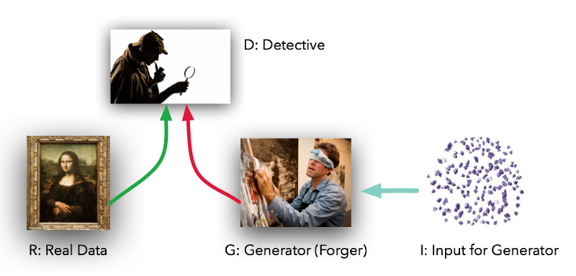
Generative Adversarial Networks (GANs)

Slide 8
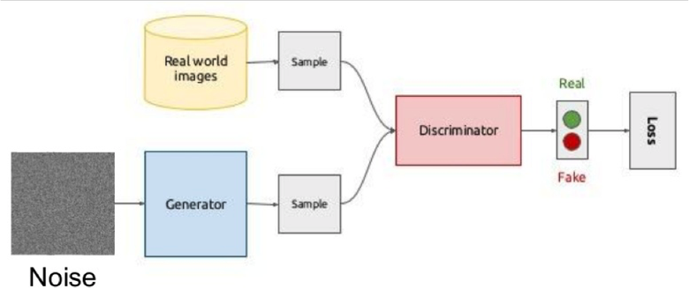
Generative Adversarial Networks (GANs)

Slide 9
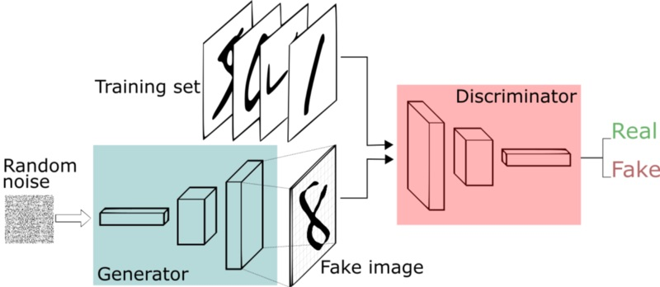
Generative Adversarial Networks (GANs)

Slide 10
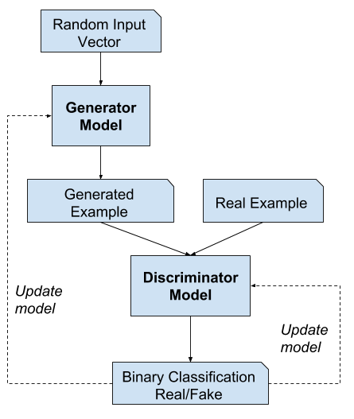
GAN Components
Generator - Model that is used to generate new plausible examples from the problem domain.
Discriminator - Model that is used to classify examples as real (from the domain) or fake (generated).
Limiting condition: Generator generates perfect replicas from the input domain every time, and the discriminator cannot tell the difference and predicts “unsure” (e.g. 50% for real and fake) in every case.
Source: https://machinelearningmastery.com/what-are-generative-adversarial-networks-gans/

Slide 11
GAN Loss Functions
minimax loss: The loss function used in the paper that introduced GANs.
Wasserstein loss: The default loss function for TF-GAN Estimators. First described in a 2017 paper.
https://developers.google.com/machine-learning/gan/loss

Slide 12
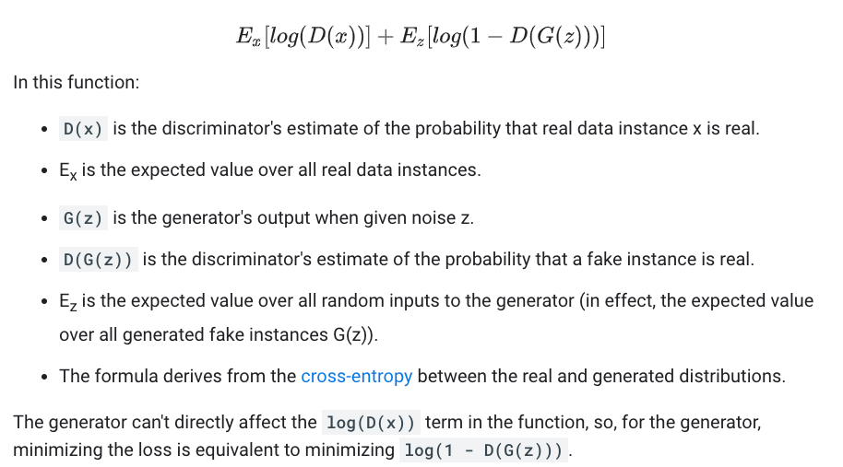
GAN Loss Functions: Minmax loss

Slide 13
GAN Loss Functions: Minmax loss
Initially Discriminator has superior performance than generator.
Generator cannot learn as quickly as discriminator.
Overall Loss function for the generator saturates.
Vanishing Gradient Problem.
Once training has progressed, discriminator may get stuck in local minima.
Loss function for the discriminator saturates.
Generator keeps generating same few samples.
Mode Collapse Problem.
Goal is to have both (Generator and Discriminator loss functions) work together!

Slide 14
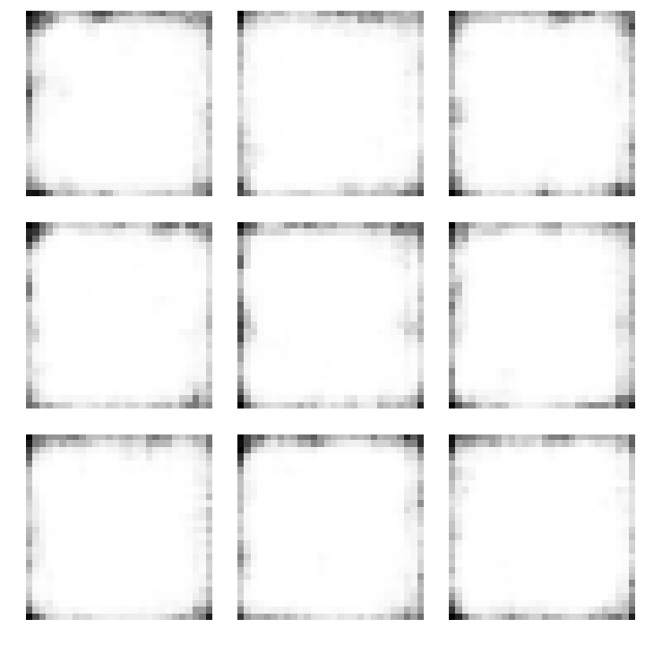
GAN training is hard

Slide 15
What happens at the end of training a GAN?
The Generator generates perfect replicas from the input domain every time,
The Discriminator cannot tell the difference and predicts “unsure” (e.g. 50% for real and fake) in every case.
Source: https://machinelearningmastery.com/what-are-generative-adversarial-networks-gans/

Slide 16
GAN Loss Functions: Wasserstein Distance
The discriminator does not actually classify instances.
For each instance it outputs a number. This number does not have to be less than one or greater than 0, so we can't use 0.5 as a threshold to decide whether an instance is real or fake. Discriminator training just tries to make the output bigger for real instances than for fake instances.
Because it can't really discriminate between real and fake, the WGAN discriminator is actually called a "critic" instead of a "discriminator".
The loss functions themselves are deceptively simple:
Critic Loss: D(x) - D(G(z))
The discriminator tries to maximize this function. In other words, it tries to maximize the difference between its output on real instances and its output on fake instances.
Generator Loss: D(G(z))
The generator tries to maximize this function. In other words, It tries to maximize the discriminator's output for its fake instances.

Slide 17
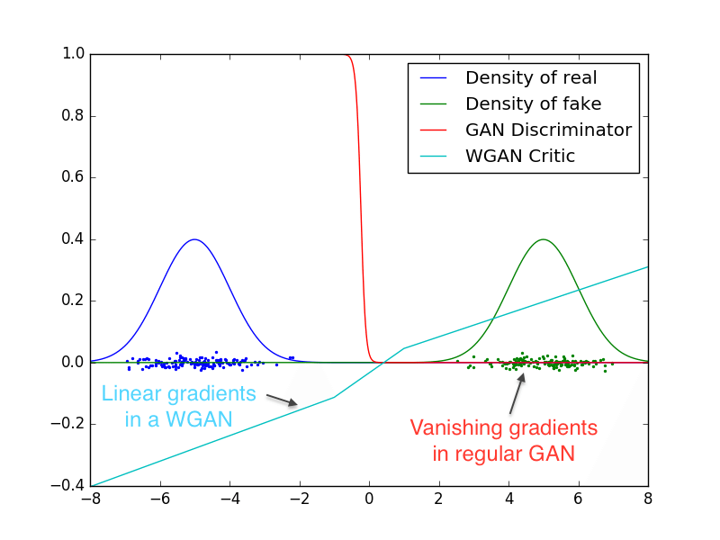
GAN Loss Functions: Wasserstein Distance
D(x) is the critic's output for a real instance.
G(z) is the generator's output when given noise z.
D(G(z)) is the critic's output for a fake instance.
The output of critic D does not have to be between 1 and 0.
The formulas derive from the earth mover distance between the real and generated distributions.
https://paperswithcode.com/method/wgan

Slide 18
GAN Loss Functions: Wasserstein Distance
Wasserstein Distance loss has smoother gradient.
Involves the discriminator to be updated more often (e.g. five times more often) than the generator model.
Discriminator (critic) scores images with a real values instead of probability.
Requires that model weights be kept small, e.g. clipped to a hypercube of [-0.01, 0.01].
Score is calculated such that the distance between scores for real and fake images are maximally separate.
Loss function implemented by calculating the average predicted score across real and fake images and multiplying the average score by 1 and -1 respectively. This has the desired effect of driving the scores for real and fake images apart.
Advantage: It provides a useful gradient almost everywhere, allowing for the continued training of the models.
Lower Wasserstein loss correlates with better generator image quality.
https://paperswithcode.com/method/wgan

Slide 19
Types of GAN Models
Conditional GANs
pix2pix (DCGAN)
CycleGAN

Slide 20
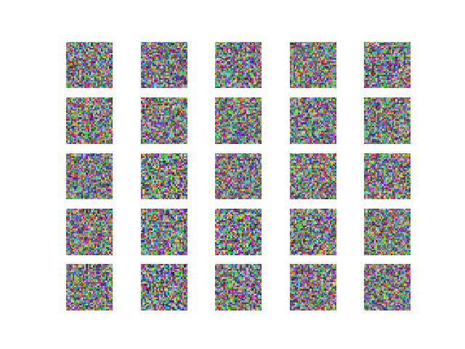
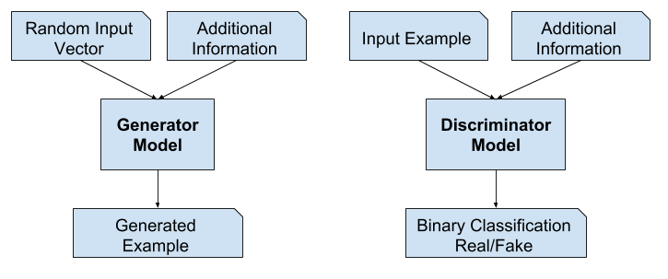
Conditional GAN
Used for conditionally generating an output.
Generator has additional meta information, e.g. gender (faces), digit (handwriting)
Discriminator has additional input, regarding the class label.
Source: https://machinelearningmastery.com/what-are-generative-adversarial-networks-gans/
https://towardsdatascience.com/understanding-and-optimizing-gans-going-back-to-first-principles-e5df8835ae18

Slide 21
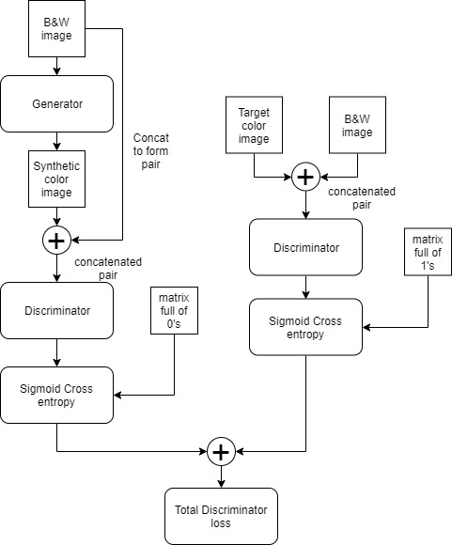
Pix2pix GAN
GAN to for image-to-image translation.
Type of conditional GAN, where the generation of the output image is conditional on an input/source image.
Generator model outputs new plausible synthetic images.
Discriminator model classifies images as real (from the dataset) or fake (generated).
https://hackerstreak.com/pix2pix-gan/

Slide 22
Pix2pix GAN
The discriminator model is updated directly; generator model updated via the discriminator.
Discriminator is provided both with a source image and the target image and must determine whether the target is a plausible transformation of the source image.
Generator is trained via adversarial loss, which encourages the generator to generate plausible images in the target domain.
Generator updated via L1 loss measured between the generated image and the expected output image (prevent mode collapse)
This loss encourages the generator model to create plausible translations of the source image.

Slide 23
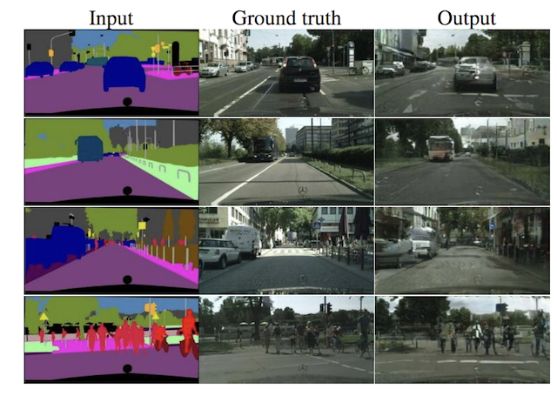
Pix2pix example
https://colab.research.google.com/drive/182CGDnFxt08NmjCCTu5jDweUjn3jhB2y#scrollTo=N1N7xi_MetRp
https://www.semanticscholar.org/paper/Matching-Adversarial-Networks-M%C3%A1ttyus-Urtasun/95549a8692f734b978f1177c76242e074d52e67a/figure/6
Notes:
70x70 Patches most effective for image translation (patchGAN)

Slide 24
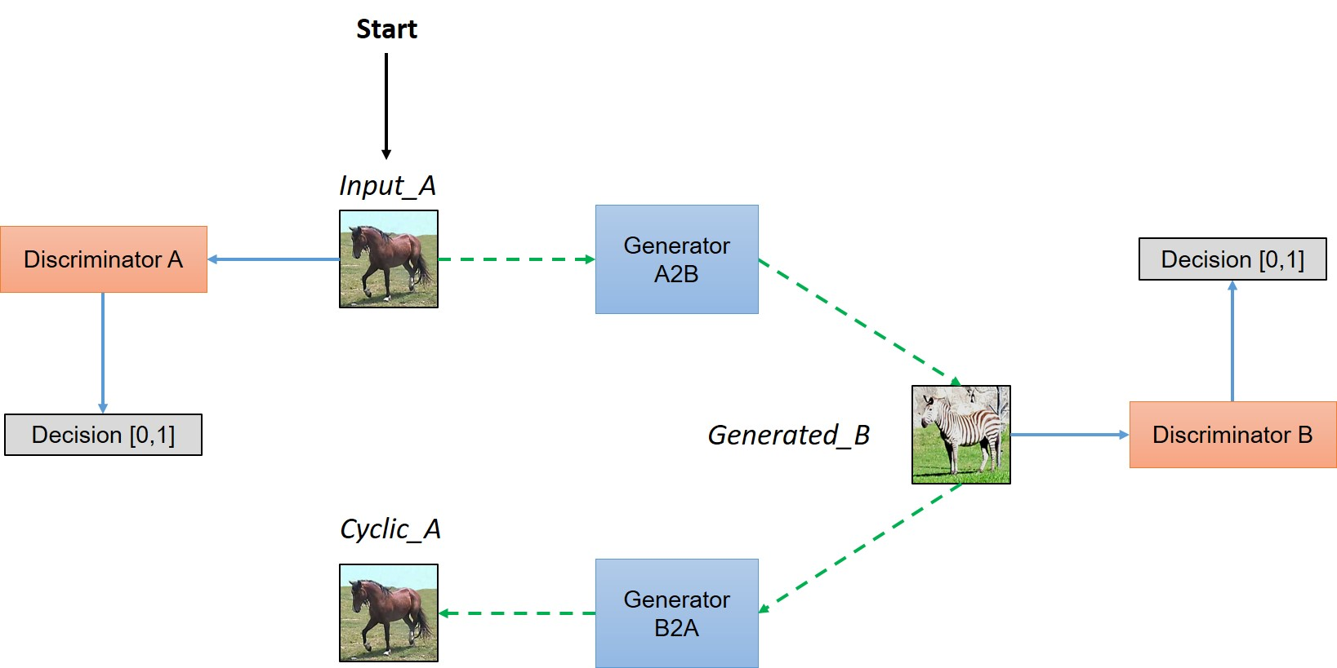
CycleGANs
Automatic image-to-image translation models without paired examples.
Simultaneous training of two generator models and two discriminator models (Ga2b, Da / Gb2a, Db).
Ga2b: Takes images from the first domain as input and outputs images for the second domain.
Gb2a: Takes images from the second domain as input and generates images for the first domain.
Discriminator models determine plausibility of generated images and update the generator.
https://hardikbansal.github.io/CycleGANBlog/

Slide 25
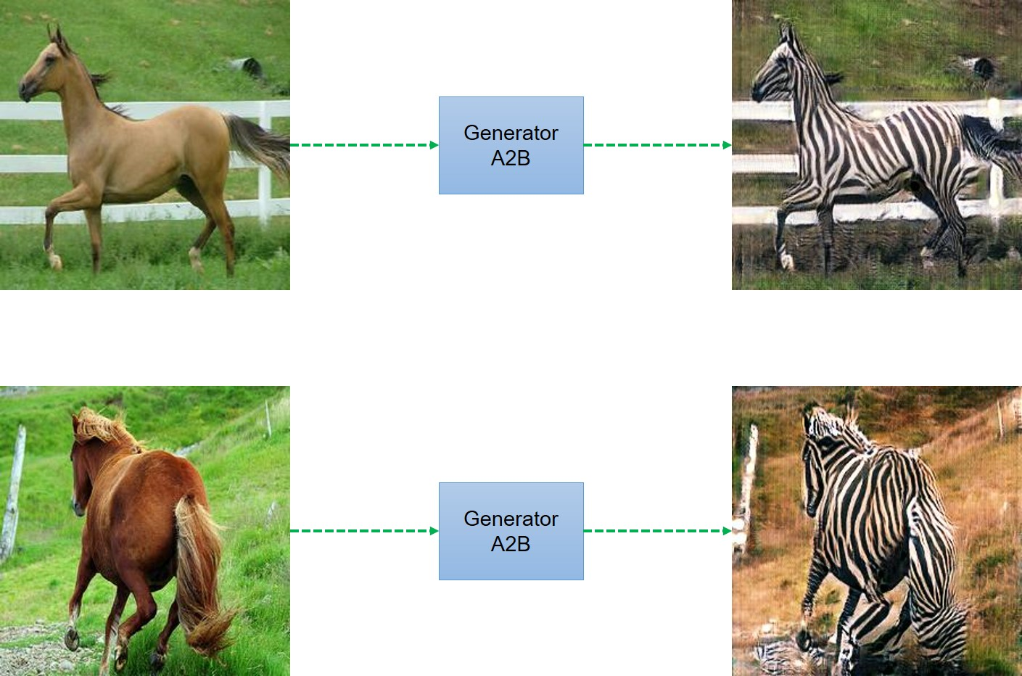
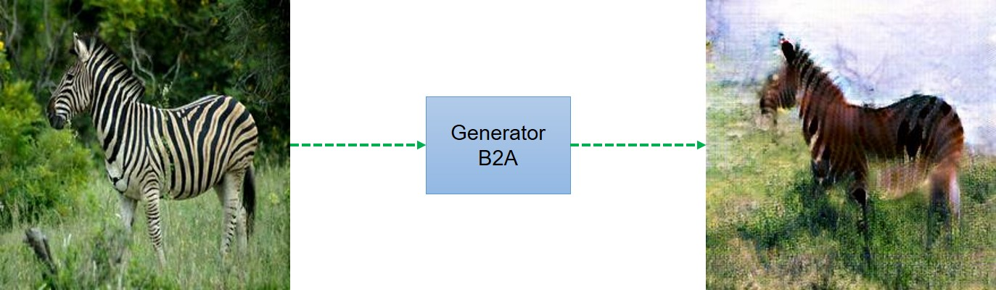
CycleGANs
https://hardikbansal.github.io/CycleGANBlog/

Slide 26
CycleGANs
Day
Gb/Db
Ga/Da
Night
Uses an additional extension to the architecture called cycle consistency:
Say Day (Domain a) -> Night generator (Domain b).
Two GANs, Domain a: Day-> Night, Domain b: Night-> Day.
Encourages cycle consistency by adding an additional loss to measure the difference between the generated output of the second generator and the original image, and the reverse.
This acts as a regularization of the generator models, guiding the image generation process in the new domain toward image translation.

Slide 27
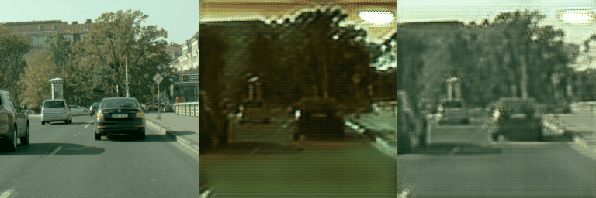
CycleGAN Loss functions
Forward Cycle Consistency Loss:
Input photo of Day (Domain a) to GAN 1
Output photo of Night from GAN 1
Input photo of Night from GAN 1 to GAN 2
Output photo of Day from GAN 2
Compare photo of Day (Domain a) to photo of Day from GAN 2
Backward Cycle Consistency Loss:
Input photo of Night (Domain b) to GAN 2
Output photo of Day from GAN 2
Input photo of Day from GAN 2 to GAN 1
Output photo of Night from GAN 1
Compare photo of Night (Domain b) to photo of Night from GAN 1
https://github.com/simontomaskarlsson/CycleGAN-Keras

Slide 28
5-minute break!
What should you do during the break?
Turn off your video & microphone
Get up! Move your body!
Try to not look at your phone or other websites. It should be a screen and information break so you are ready to focus on the next section.
Notes:
Remember to mute it

Slide 29
Tuesday Agenda
4:00 - 4:15: Welcome & Review
4:15 - 5:00: Generative Adversarial Nets (GANs) Introduction
5:00 - 5:05: Break
5:05 - 5:55: Live Assignment
5:55 - 6:00: Break
5:00 - 5:55: Generative Adversarial Nets (GANs) Applications and Limitations
6:50 - 7:00: Wrap-up

Slide 30
Saturday Agenda
9:00 - 9:25: Welcome & Review
9:25 - 9:55: Image segmentation
9:55 - 10:00: Break
10:05 - 10:55: Live Assignment
10:55 - 11:00: Break
11:05 - 11:55: Problem Solving for Technical Interviews
11:55 - 12:00: Wrap-up
12:00 - 12:30: Lunch break

Slide 31
Live Assignment: Machine Learning @Uber_Perception [Aiding Data Augmentation for Autonomous Drive]

Slide 32
The Problem
Implement CycleGAN to achieve Day to Night Translation.

Slide 33
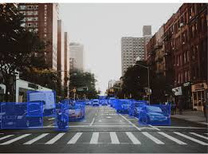
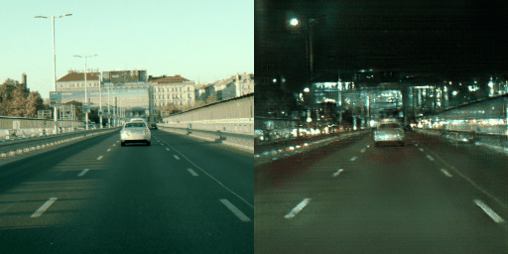
Overall System Design: End-to-end Process
Night to Day Generator/ Discriminator
You are here
Day to Night Generator/Discriminator
Forward/backward Cycle Loss
Feedback
Aids Data augmentation,
Robust Object Detection
Daytime Image collected and annotated for bounding boxes.

Slide 34
Breakout Rooms

Slide 35
5-minute break!
What should you do during the break?
Turn off your video & microphone
Get up! Move your body!
Try to not look at your phone or other websites. It should be a screen and information break so you are ready to focus on the next section.
Notes:
Remember to mute it

Slide 36
Tuesday Agenda
4:00 - 4:15: Welcome & Review
4:15 - 5:00: Generative Adversarial Nets (GANs) Introduction
5:00 - 5:05: Break
5:05 - 5:55: Live Assignment
5:55 - 6:00: Break
5:00 - 5:55: Generative Adversarial Nets (GANs) Applications and Limitations
6:50 - 7:00: Wrap-up

Slide 37
Saturday Agenda
9:00 - 9:25: Welcome & Review
9:25 - 9:55: Image segmentation
9:55 - 10:00: Break
10:05 - 10:55: Live Assignment
10:55 - 11:00: Break
11:05 - 11:55: Problem Solving for Technical Interviews
11:55 - 12:00: Wrap-up
12:00 - 12:30: Lunch break

Slide 38
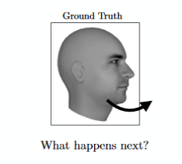
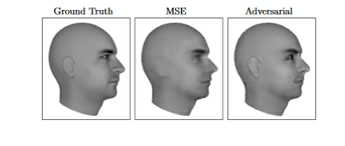
GAN applications: Predicting the next frame in a video

Slide 39
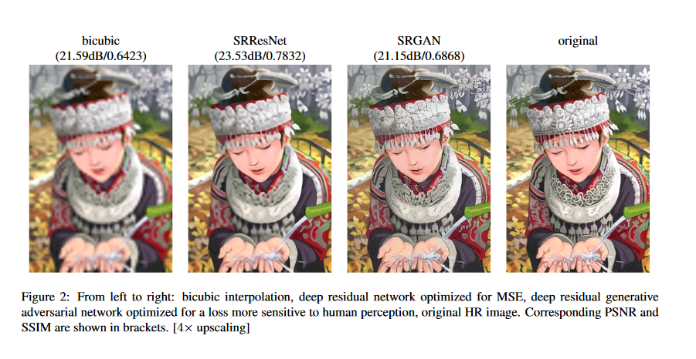
GAN applications: Increasing resolution of an image

Slide 40
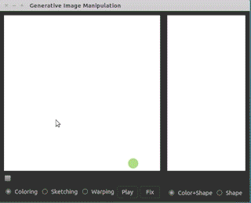
GAN applications: Interactive Image Generation

Slide 41
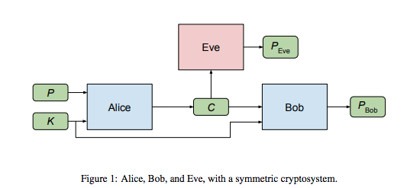
GAN applications: Invent Novel Encryption

Slide 42
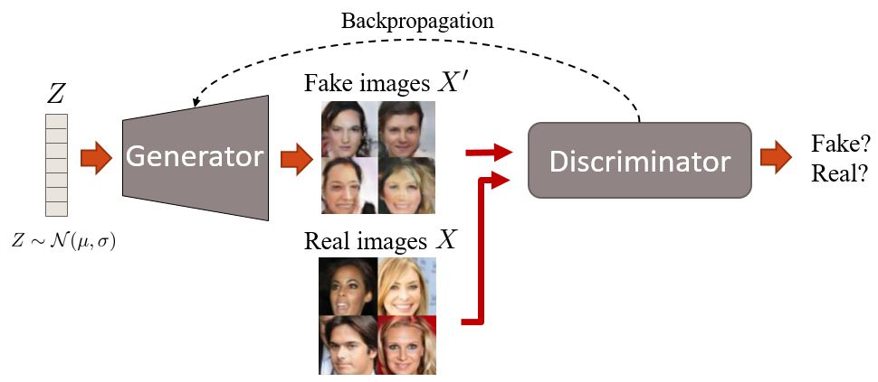
GAN applications: generate realistic fake people

Slide 43
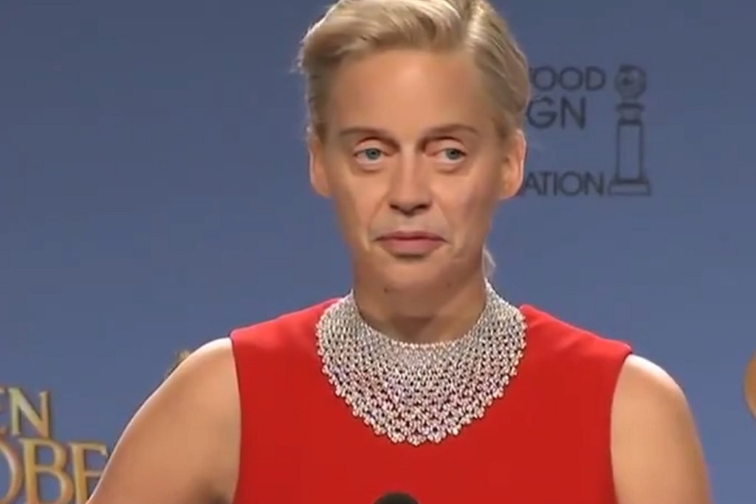
GAN applications: generate realistic fake people

Slide 44
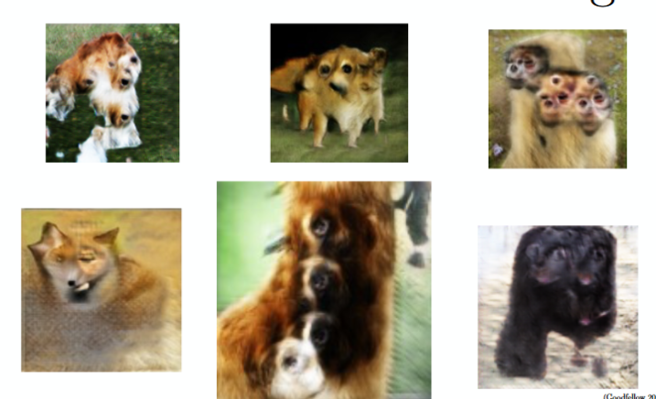
Common GAN problems Proper enumeration
Notes:
If two eyes are good, five eyes are great!

Slide 45
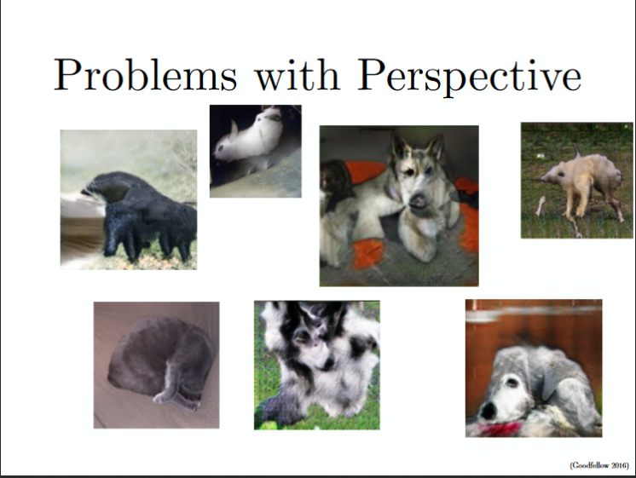
Common GAN problems
Notes:
GANs only train on 2D images and have no way to understand our 3D world.

Slide 46
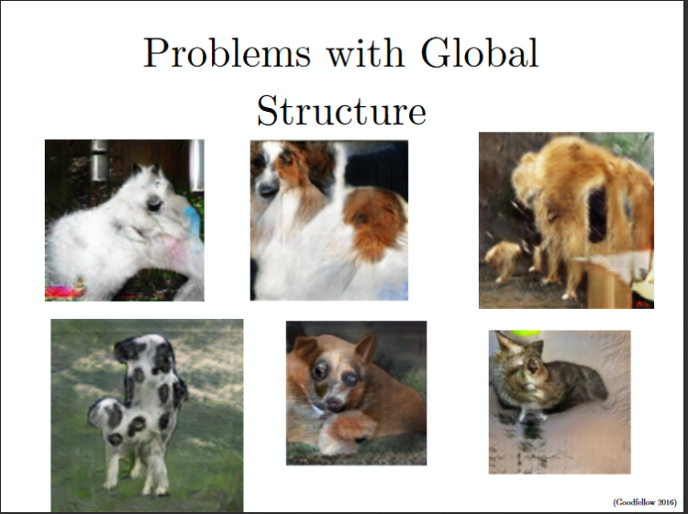
Common GAN problems
Notes:
GANs do not understand "scenes"

Slide 47
GAN limitations
GANs need to perturb noise to become realistic.
Works best in continuous spaces, like pixels.
Words are not continuous and therefore hard to perturb in small, meaningful ways.
A good adaption of GANs to NLP is very difficult (even using word embeddings).
Notes:
GANs do not understand "scenes"

